Slide 1
NovelComix
6002CEM Mobile App Development
Group 2
Members:
Damien Tan Lek Khee
Lim Pau Thing
Ooi Ying Jie

Slide 2
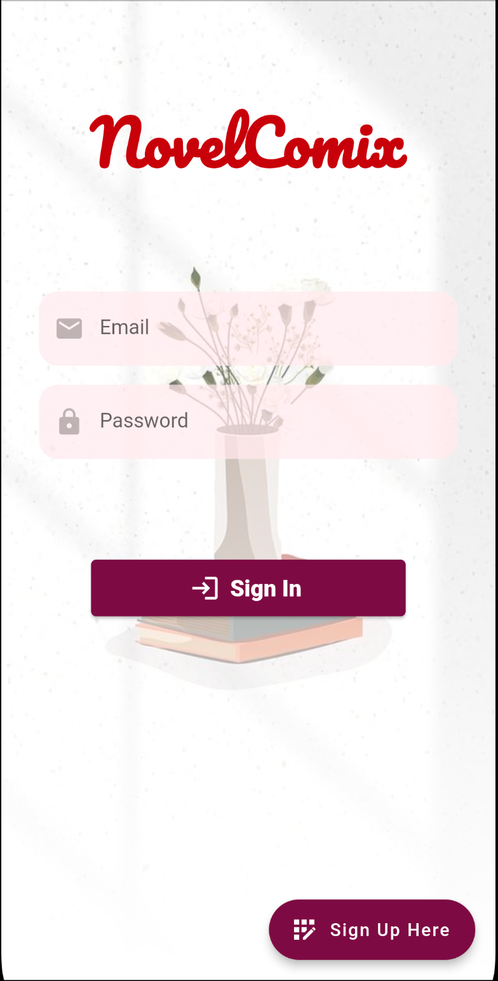
Login Page
User greeted with the login page on app startup
2 inputs will be required to login to the app
Sign up button will direct users to the sign up page

Slide 3
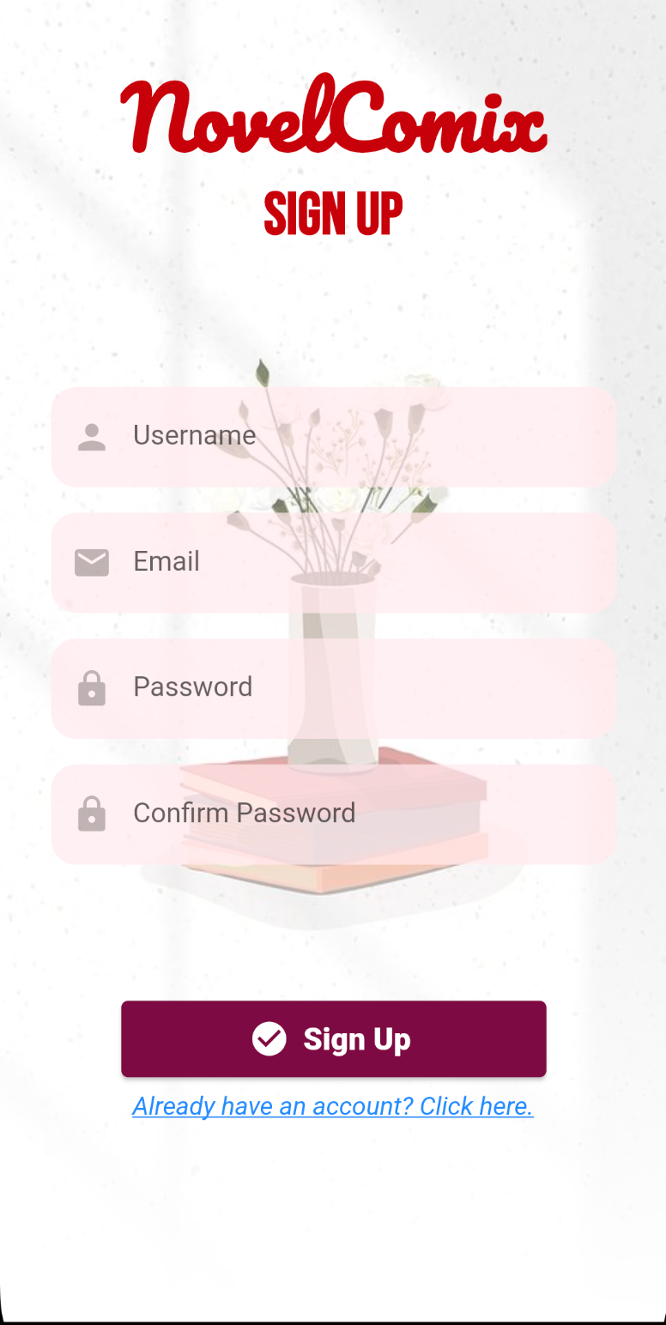
Sign up Page
Users could enter login details
All fields are required to successfully register an account
An option for users to go back to the login page

Slide 4
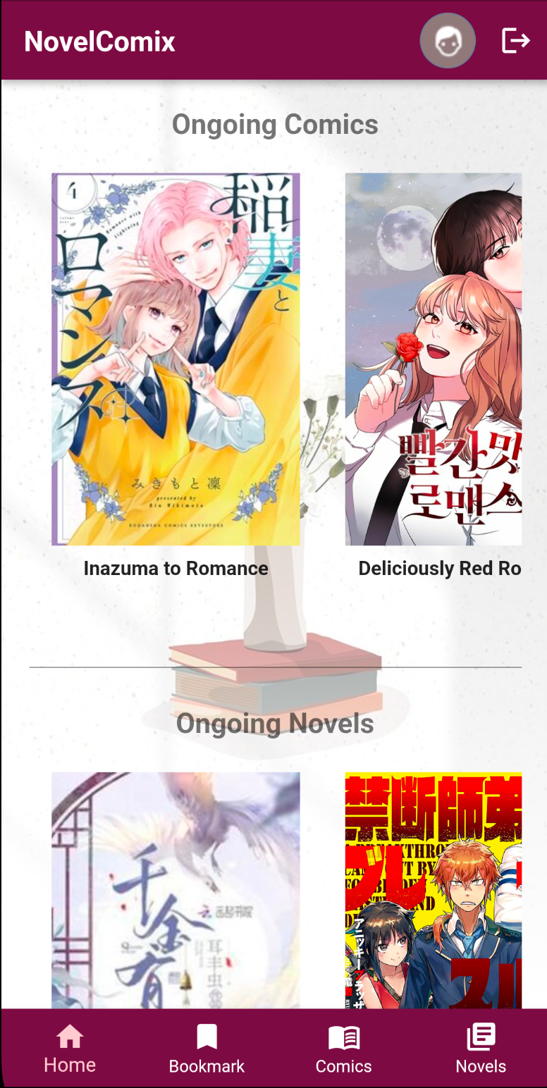
Home Page
Displays and recommends the ongoing comics and novels
Bottom navigation bar for ease of use
Profile button directs users to the profile page
Log out button on the top right of the page

Slide 5
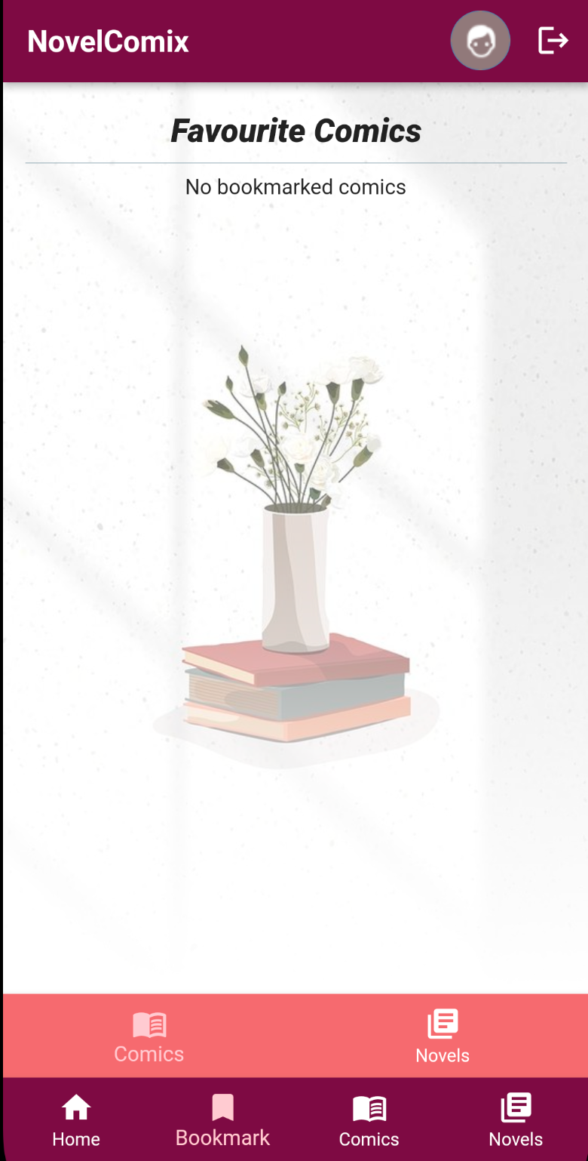
Bookmark Page
Displays all users’ favourite comics or novels

Slide 6
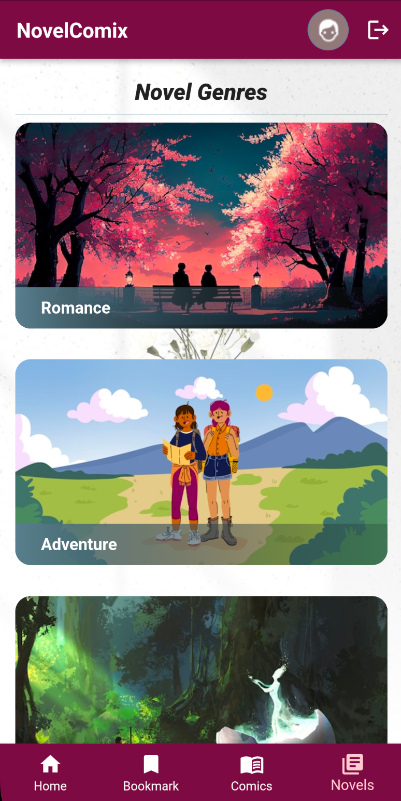
Novel Page
Users will be directed to this page when the novel icon in the nav bar is clicked
Novels are categorized based on genres

Slide 7
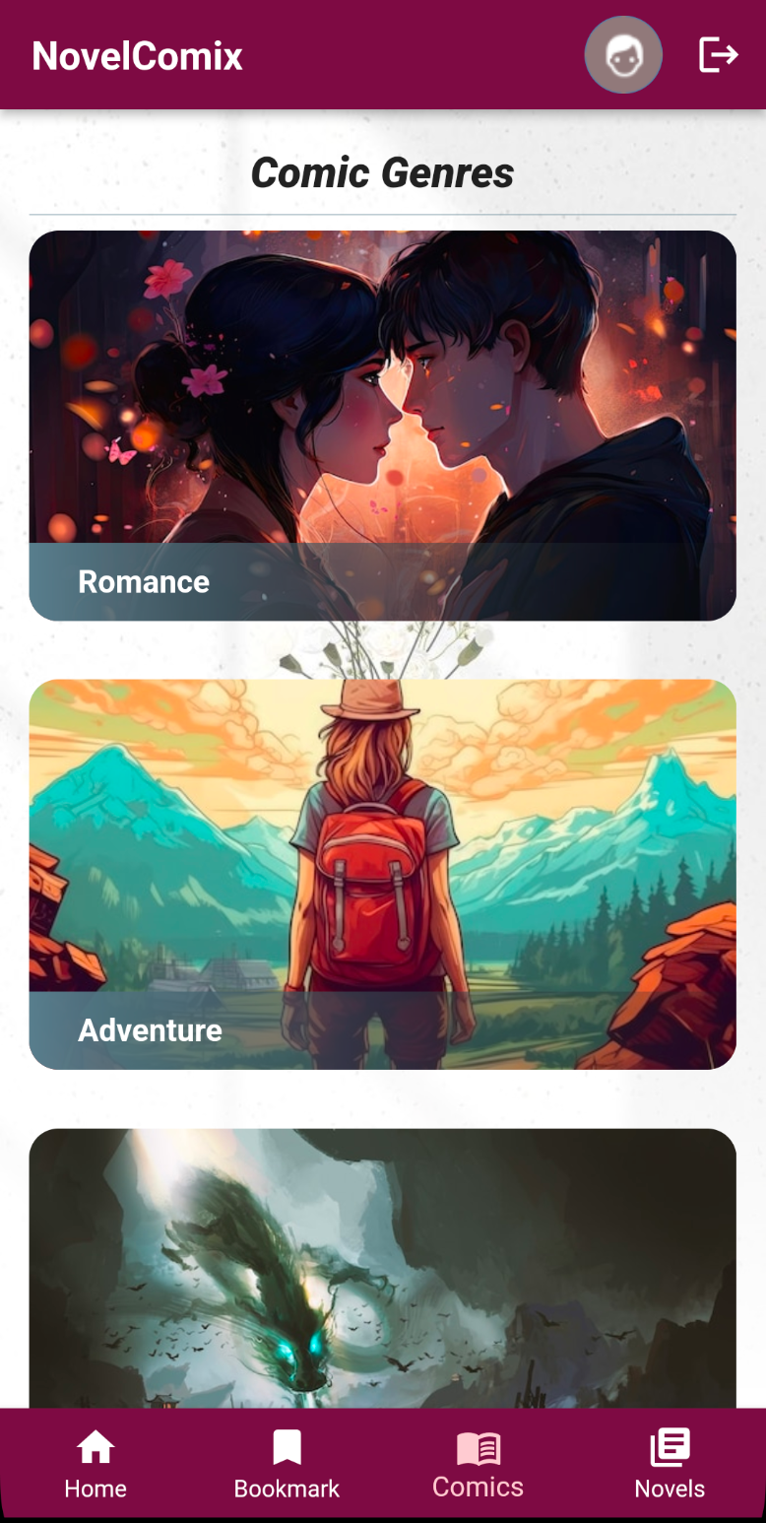
comics Page
Users will be directed to this page when manga icon in the nav bar is clicked
Mangas will be categorized in genres

Slide 8
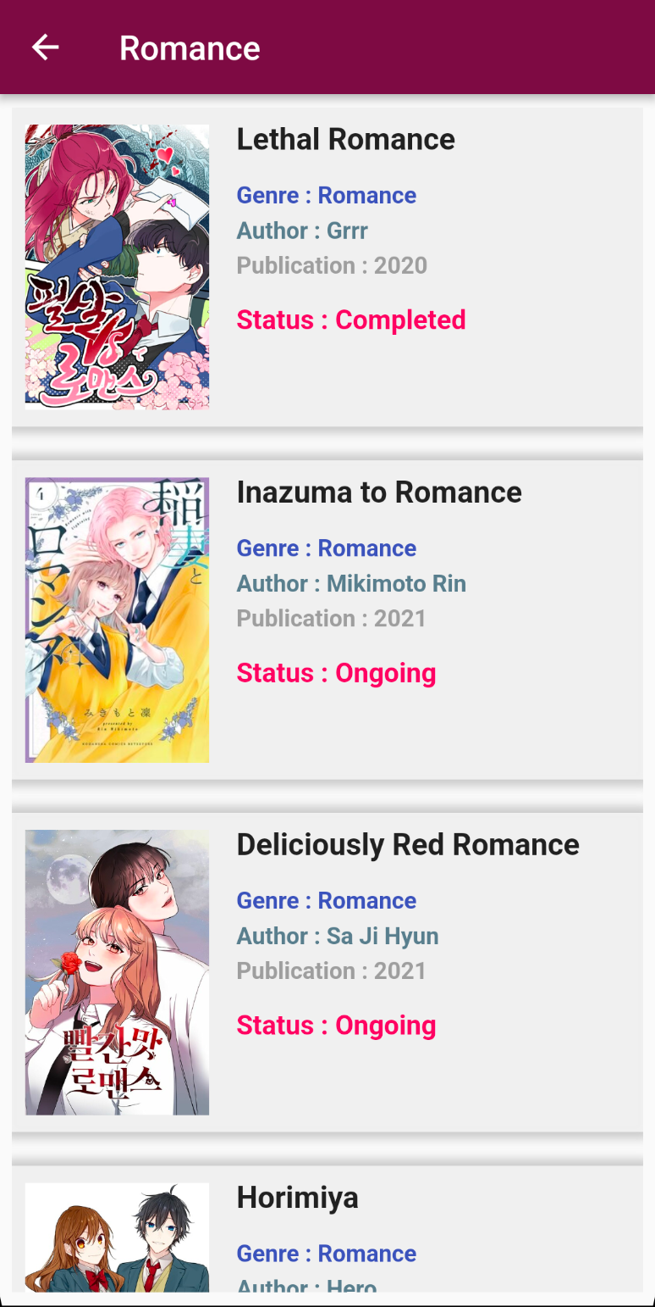
Catalogue list Page
Users will be directed to this page when they selected one of the genres from the comics or novels page
Users will be directed to the book details page when they click on one of the books

Slide 9
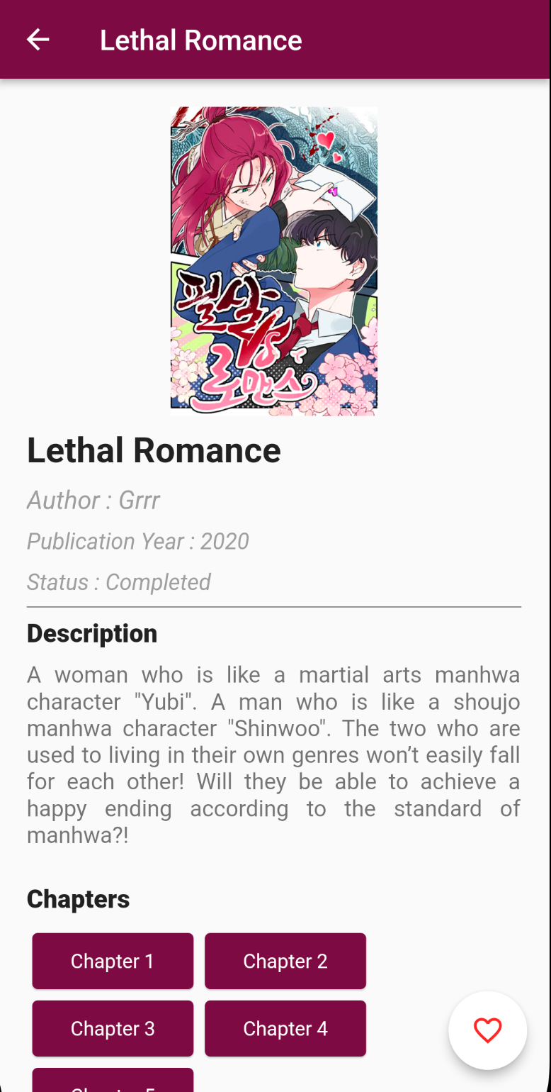
Book details Page
Displays the details of a specific book that the user selected

Slide 10
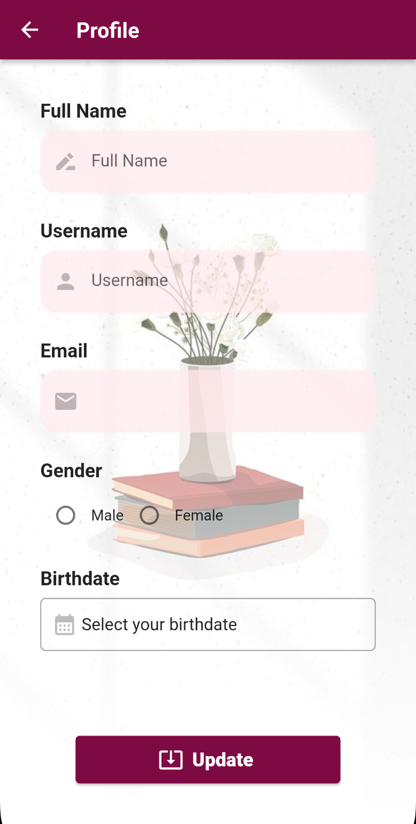
profile Page
When the profile icon in the home page is clicked, users will be directed to this page
Users can only modify full name, username, gender and birth date
Email address could not be modify and it is based on the email registered to the account

Slide 11
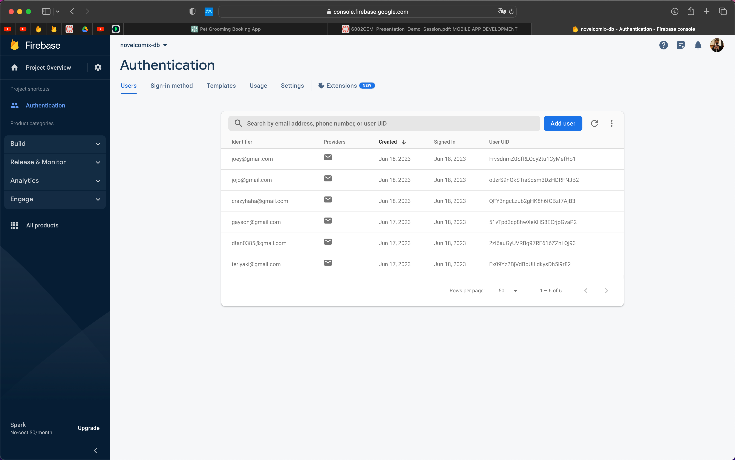
Firebase authenticator
Firebase authenticator is used for login and signup

Slide 12
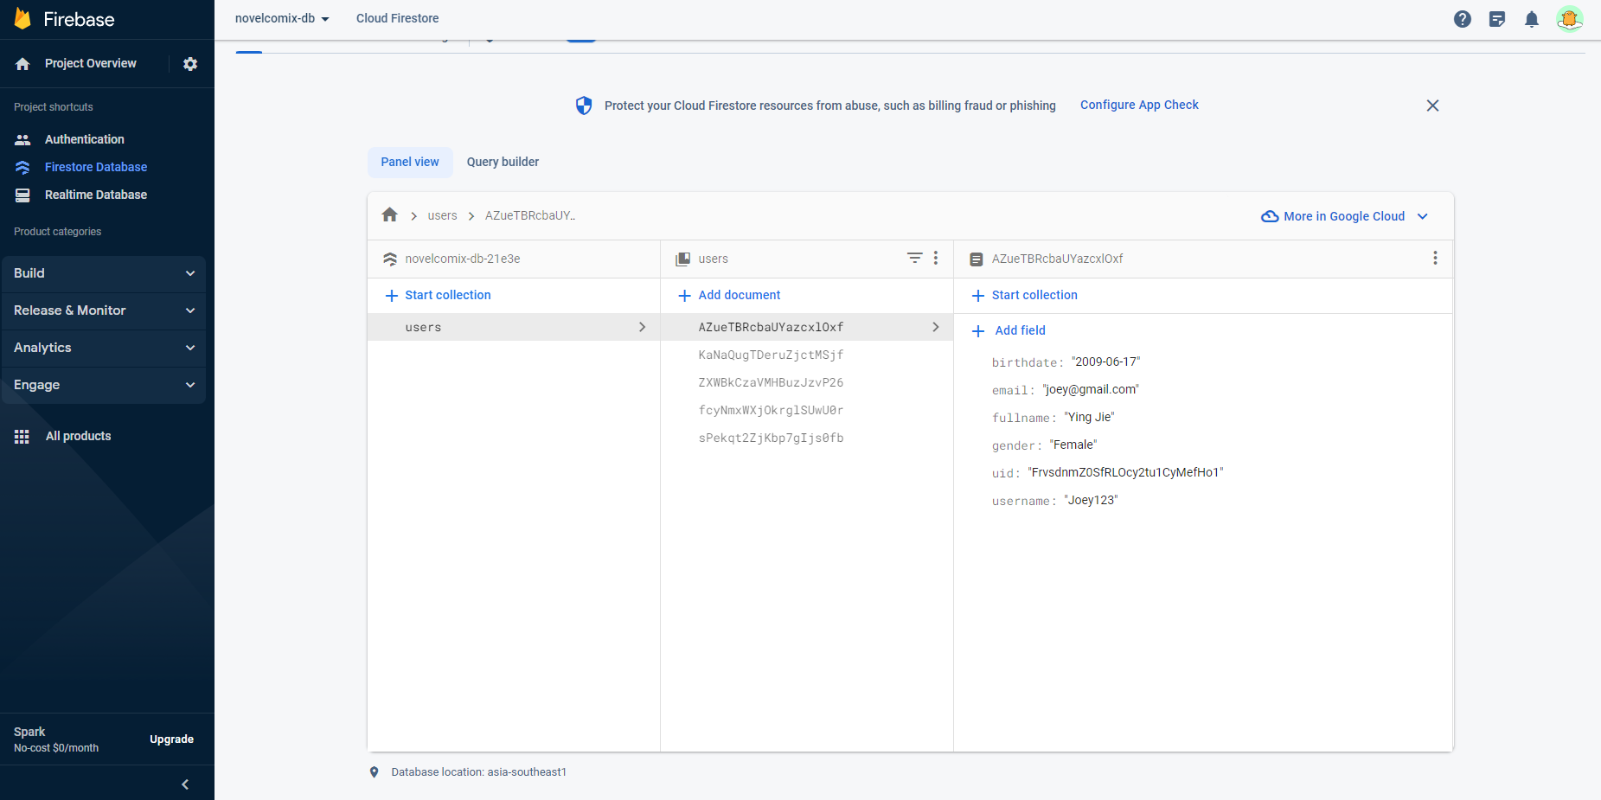
Firebase firestore
Firestore is used to store user details

Slide 13
Thank you

